Slide 1
XGBoost (eXtreme Gradient Boosting)
By sharan

Slide 2
XGBoost: Optimized Gradient Boosting
Definition: XGBoost (eXtreme Gradient Boosting) is a highly optimized, scalable, and efficient implementation of the Gradient Boosting Decision Tree (GBDT) framework.
GBDT Review: New models are trained to predict the residuals (errors) of the previous model, gradually correcting the overall prediction. This is equivalent to performing gradient descent in function space.
The "Extreme" Edge: XGBoost goes beyond traditional GBDT by introducing powerful innovations for performance and control.

Slide 3
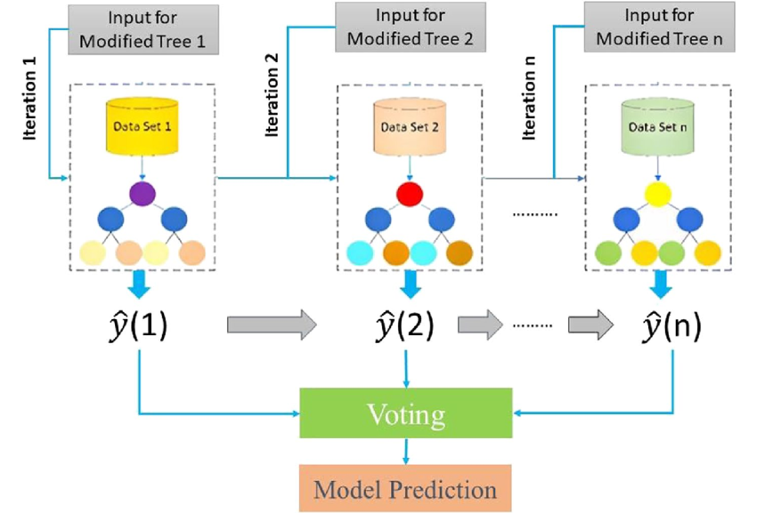

Slide 4
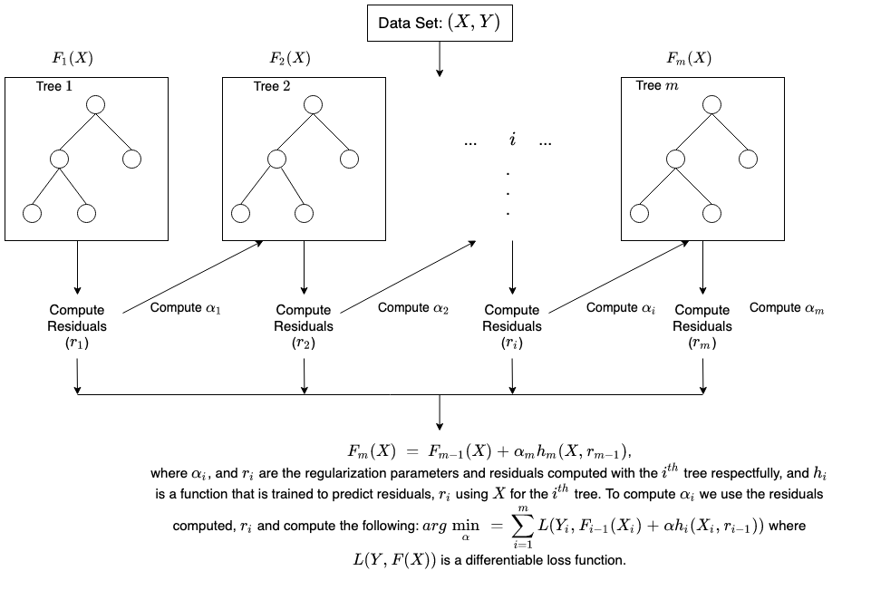

Slide 5
XGBoost Tree Construction and Features
Level-wise (Breadth-First) Tree Growth: XGBoost builds trees level-by-level.
It evaluates all potential splits at a given depth before moving to the next level.
Advantage: This supports parallel computation of splits within a level, significantly speeding up the training process.
Handling Missing Values: XGBoost has a built-in strategy:
At a node, it learns the best default direction (left or right) for samples with missing feature values.
Column Block for Parallelism: Data is stored in in-memory Column Blocks and sorted by feature values once. This allows for parallel computation of split finding across features.

Slide 6
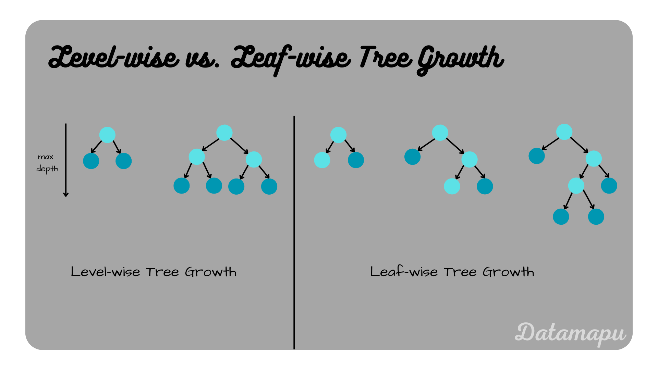

Slide 7
XGBoost Performance and Use Cases
Performance: Excellent combination of high accuracy and computational speed (due to parallelism and optimization).
Use Cases: It has become the default choice for many structured data prediction problems, particularly in data science competitions (Kaggle).
  Classification and Regression.
  Ranking problems.
Ecosystem: Widely adopted, well-documented, and supports distributed and GPU computing.

Slide 8
CONCLUTION
XGBoost successfully evolved the traditional Gradient Boosting Machine (GBM) into a highly optimized and scalable algorithm that has become the de facto industry standard for structured data problems, particularly in machine learning competitions.
Key Strengths & Innovations
Accuracy and Robustness: Achieves state-of-the-art predictive performance by using a more precise second-order Taylor expansion of the loss function.
Regularization: It introduced L1 and L2 regularization directly into the objective function, which is critical for controlling model complexity and preventing overfitting—a major improvement over vanilla GBM.
Computational Efficiency: Its level-wise tree growth and cache-aware block structure allow for parallel processing, drastically speeding up training time compared to its predecessors.
Feature Completeness: It includes built-in capabilities for handling sparse data and missing values, reducing the need for extensive manual data preprocessing.

